Slide 1
PM 2.5 Index Prediction and Web Application Design
Ruofan Wang
Lu Yin
Shenghui Zhou

Slide 2
Air pollution in China
Introduction
Motivations and Goals
Data Visualization and Analysis
Web Design and Application
Conclusion

Slide 3
Motivation and Goal
Observes the PM 2.5 data from the online resources and then fits the data into the several models to predict future PM 2.5 index. We choose the model based on the MSE and RMSE of the models
Designs a web application and interface using Python, HTML and CSS in order to demonstrate our predictions and enable users to plan their activities wisely.
Introduction
Motivations and Goals
Data Visualization and Analysis
Web Design and Application
Conclusion

Slide 4
Data Cleaning and Preparation
We initially plot three figures that showing the PM2.5 distribution in three stations, which are the city station,5th Middle School and US Post within the five years.
Since the location of 5th Middle School shares the most popularity and data with less missing, we decide to make prediction that focus on the data collection from this particular area.

Slide 5
Data Visualization and Analysis
Multi-linear Regression
Decision tree and Random Forest
XGBoost Regressornclusion
ARIMA model
Introduction
Motivations and Goals
Data Visualization and Analysis
Web Design and Application
Conclusion

Slide 6
Multilinear Regression
We choose MLR model as our baseline model.
Introduction
Motivations and Goals
Data Visualization and Analysis
Web Design and Application
Conclusion

Slide 7
Tree-based models
Decision Tree
Random Forest
XGBoost Regressor
Introduction
Motivations and Goals
Data Visualization and Analysis
Web Design and Application
Conclusion

Slide 8
ARIMA model
From the ADF test result, we can see the p-value is 3e−22, which is strong enough to reject the original hypothesis. Also, the value of this test is −11.9, which is smaller than the three threshold in the levels of1%,10%,5%. So we can assume that our data is stationary.
Introduction
Motivations and Goals
Data Visualization and Analysis
Web Design and Application
Conclusion

Slide 9
ARIMA model
According to the AIC results, we select ARIMA(1,0,1)∗(0,1,1,12) as our model.
Introduction
Motivations and Goals
Data Visualization and Analysis
Web Design and Application
Conclusion

Slide 10
Web Design and Application
As the final goal of this project, our team designs a web application to show the predictions of PM 2.5 to potential customers. More importantly, we implement the website with different labels to realize our business goals.
Our team could combine our results with the real-world business problems and help people manage their indoor and outdoor activities accordingly .
Introduction
Motivations and Goals
Data Visualization and Analysis
Web Design and Application
Conclusion

Slide 11
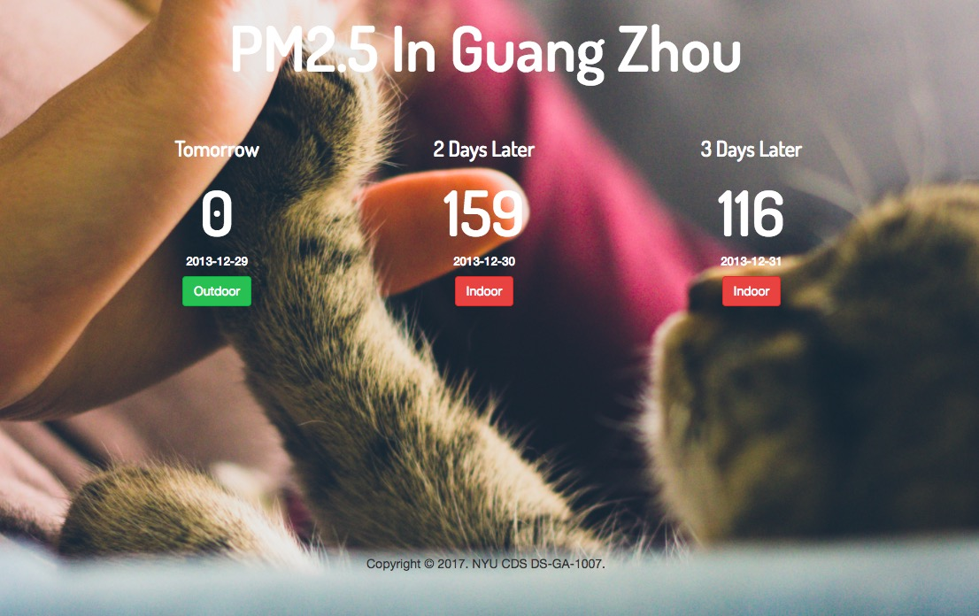
Web Design and Application
If the PM2.5 Index is higher than 100, it turns out to be red. Index higher than 100 means the outdoor activities could be harmful for human bodies. Therefore, the button would direct the users to those sellers who offer healthy products to clean air and absorb harmful PM2.5.
On the other hand, the green button means index of PM 2.5 is lower than 100 and the outdoor activities are recommended. Then, this button will direct the users to workout applications and websites for outdoor activities.
Introduction
Motivations and Goals
Data Visualization and Analysis
Web Design and Application
Conclusion

Slide 12
Conclusion
Our team explores from Multilinear regression to tree-based models and then use the ARIMA model to fit the time lagged data. Based on the evaluation of MSE for all those models, we choose the XGBoost regression as our the optimal model.
Getting the good prediction result is not our final goal. As a group of ambitious graduate students, we try to make the business value out of our predictions. By designing the Website, we direct the users to different websites based on different PM 2.5 predictions and realize the business opportunity.
Introduction
Motivations and Goals
Data Visualization and Analysis
Web Design and Application
Conclusion

